Slide 1

Predicting Post-COVID Elections Using Pre-COVID Data
How the pandemic transformed voting behavior and electoral outcomes.
Completed By:
Team 1) Michael Suder, Darrell Collison Jeong Hwan Son, Robert Nitto

Slide 2
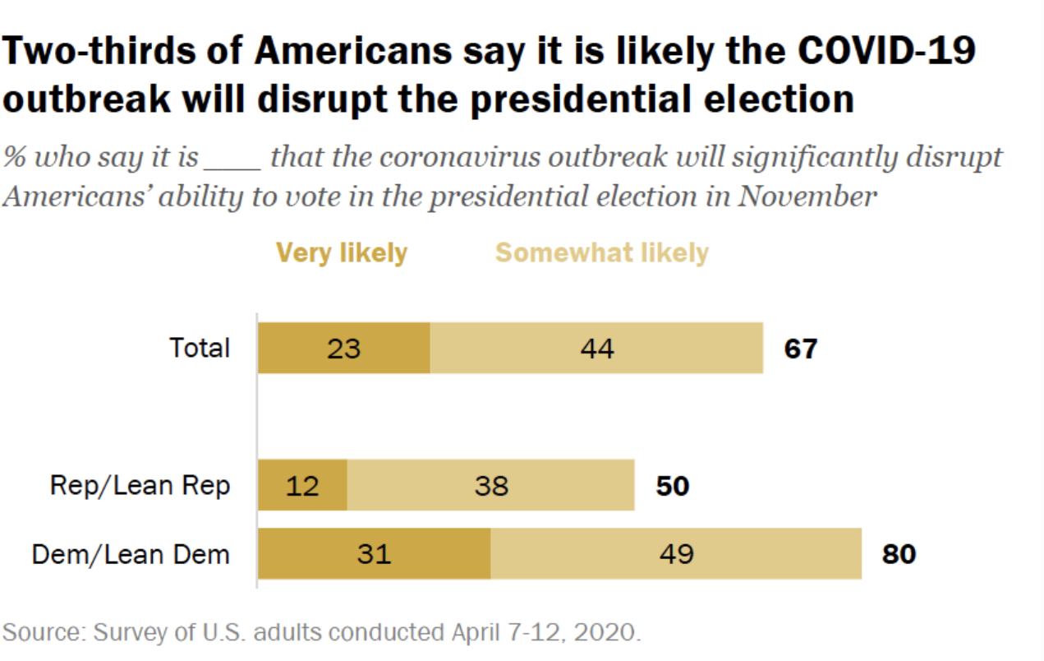
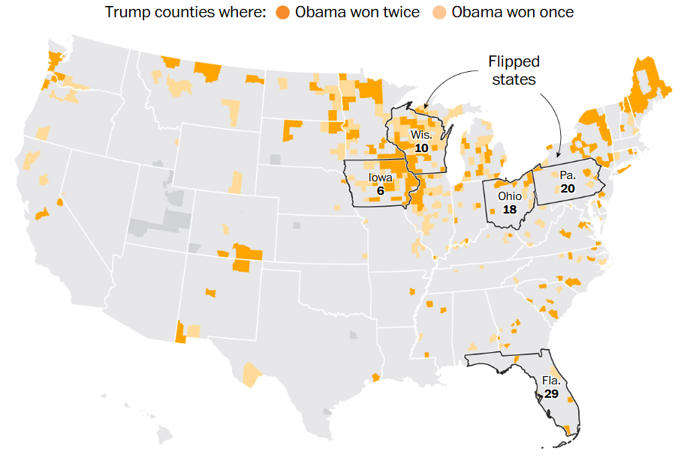
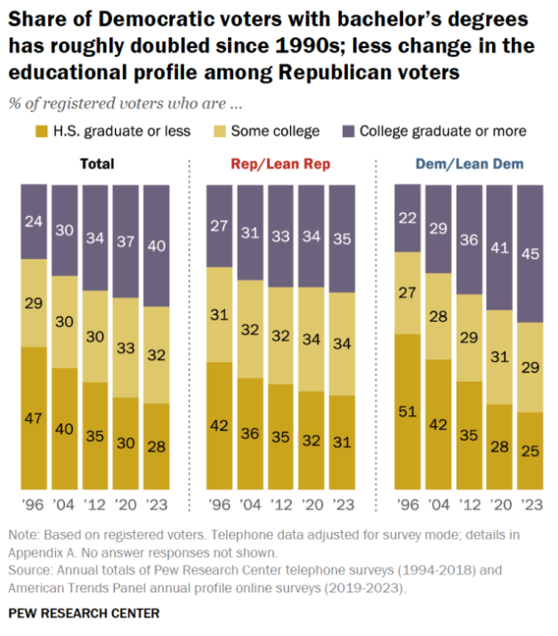
Hypothesis
The COVID-19 pandemic significantly altered voting behaviors, thereby reducing the predictive accuracy of models trained on pre-2020 data." ​
Null: COVID-19 did not affect voting behaviors in 2020 and something else affected expert's ability to predict the outcome​
Alternative: COVID-19 did affect voting behaviors in 2020 affecting expert's ability to predict the outcome
Mean Shift in Voting Patterns
Impact of Flippable Counties
Influence of Demographic Factors
We believe COVID-19 fundamentally altered the 2020 election cycle's voting patterns across demographics.
Counties with a high probability of flipping significantly influence the overall election outcome.
Demographic Factors like age, income, and education level play a significant role in voting tendencies.
https://www.pewresearch.org/politics/2020/04/28/two-thirds-of-americans-expect-presidential-election-will-be-disrupted-by-covid-19/
https://www.washingtonpost.com/graphics/politics/2016-election/obama-trump-counties/
https://www.pewresearch.org/politics/2024/04/09/the-changing-demographic-composition-of-voters-and-party-coalitions/

Slide 3
Datasets & Analytical Scope
- Demographics × Voting Outcomes
Demographics Data
Election Results
Integrated Source
2009 US Census ACS5
Pre-COVID baseline data (income, education, etc.)
2012–2020 US Census ACS5
Demographic shifts across 3 presidential cycles
MIT County Presidential Returns
Candidate vote counts by county (2000–2020)
Electoral_College
Metadata on state-level electors (for aggregation and bias analysis)
Kaggle: US Census & Election Results (2000–2020)
Combined dataset used as main modeling input

Slide 4




Preparing the Data for Analysis
Our data preparation process transforms raw information into analysis-ready datasets.
Gather Diverse Sources
US presidential election results from 2000–2020
County-level ACS demographics (2009, 2012–2020)
State-level electoral college assignments
Handle Missing Values
Estimate missing turnout by aggregating candidate-level totals
Incorporate absentee/mail-in vote trends when available
Standardize Demographics
Normalize geographic labels across all datasets
Normalize county-level formatting
Convert FIPS codes to strings to preserve leading zeros
Merge Historical Data
Align age and income categories across datasets
Compare pre/post-pandemic voting patterns
Analyze county influence on state outcomes
Evaluate electoral vote allocation changes

Slide 5
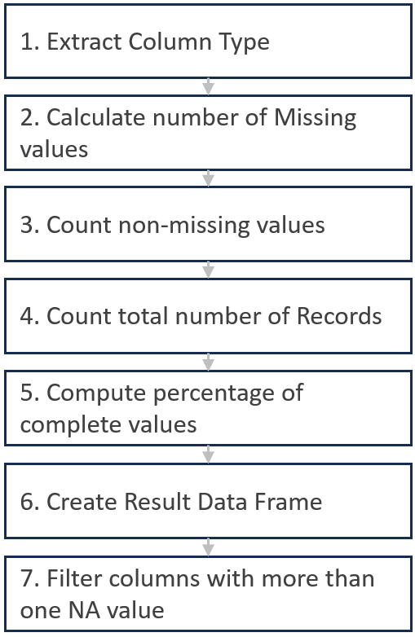
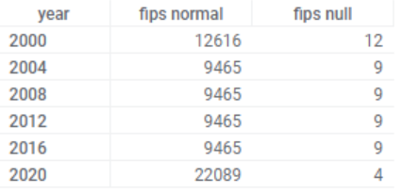
Handle Missing Values
summarizeNAs
Data Integrity
Merge
Cleaning
Remove insignificant null data
Identify Missing Data Patterns
Maintain Data Integrity & Consistency
Detect missing values and patterns associated with specific variables
Checking missing value proportions using summarizeNAs function
Assessing the impact of concentrated missing values on data analysis
Merging Process
- Combine cleaned County & Electoral dataset
- Fips code is converted to a numeric format to ensure consistency in matching
Data Cleaning
- After Merge, retain only valid county_fips values.

Slide 6
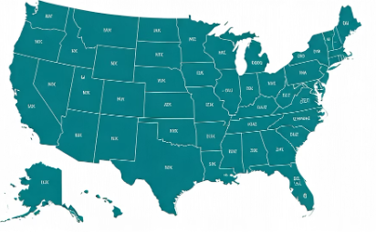


Standardize Demographics
- Demographic Data Standardization
FIPS Code Standardization
County Name Normalization
Dataset Integration
Convert numeric FIPS codes to strings
Transform inconsistent capitalization
(UPPERCASE → lowercase)
Use left_join() to merge county and election data
Preserve leading zeros for proper identification
Connect demographic profiles with voting patterns
Replace spaces with underscores for database compatibility
Ensure consistent county identification across datasets
Create analysis-ready integrated dataset
Apply clean_names() function for consistent formatting

Slide 7
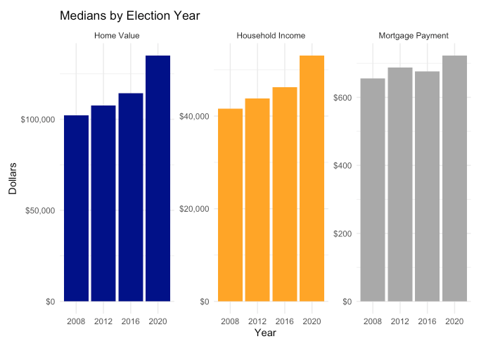
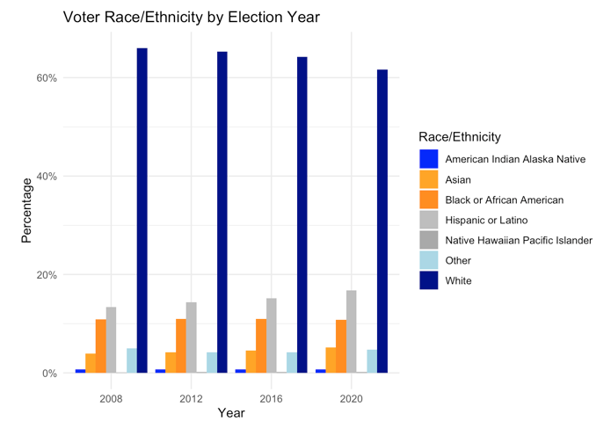
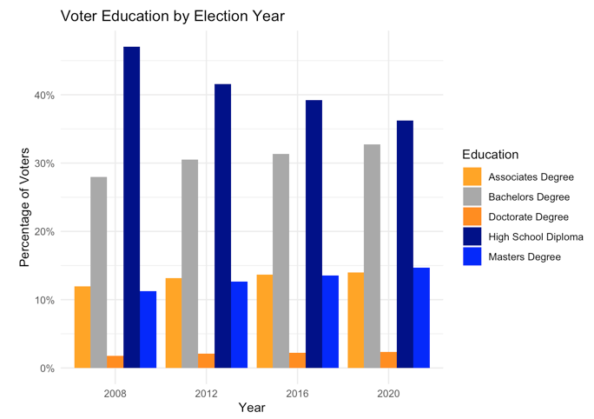
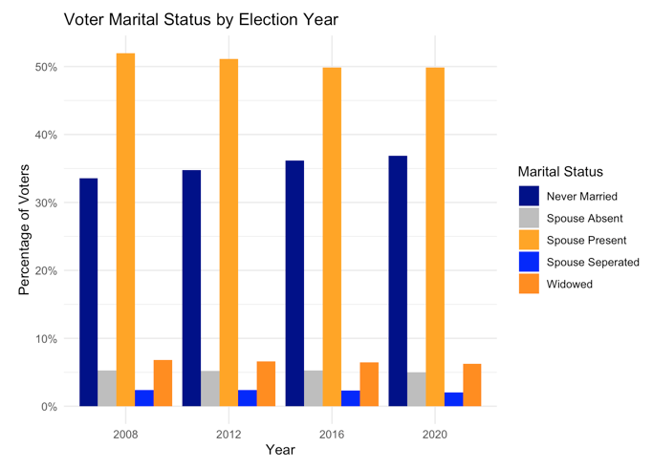
Visualizing Merged Categorical Data
The bar charts we created below help us look for trends and differences in demographic data year over year. Using this data in our model improves its ability to predict based on real-world demographic changes over time.
Increases in median home value, household income and mortgage payment between 2008 and 2020 election cycles.
Increase in Hispanic or Latino voters in the survey.
Decrease in white voters in the survey.
Increase in voters with bachelor’s degrees in the survey.
Decrease in voters with high school diploma in the survey.
Increase in voters who are never married in the survey.
Decrease in married voters in the survey.

Slide 8
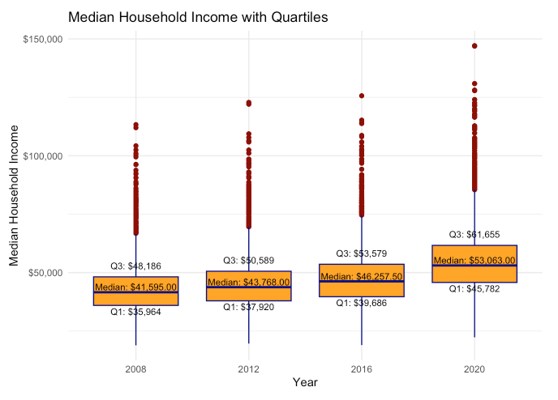
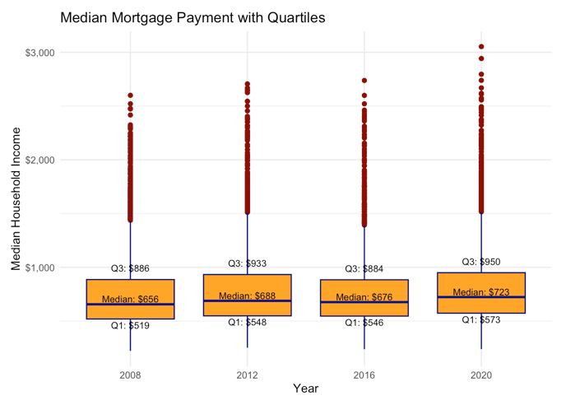
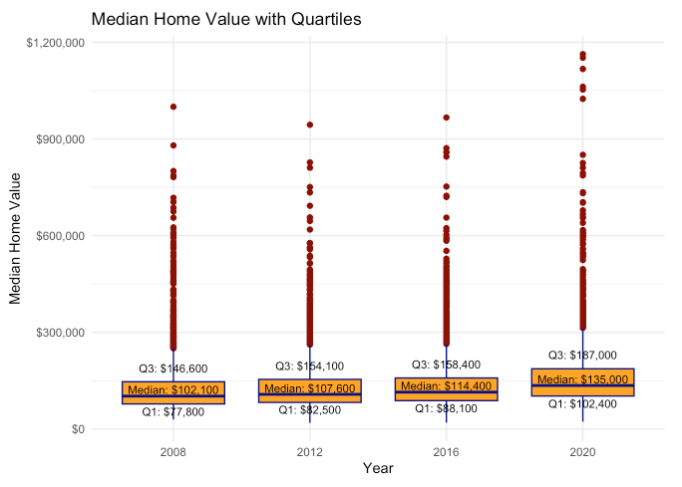
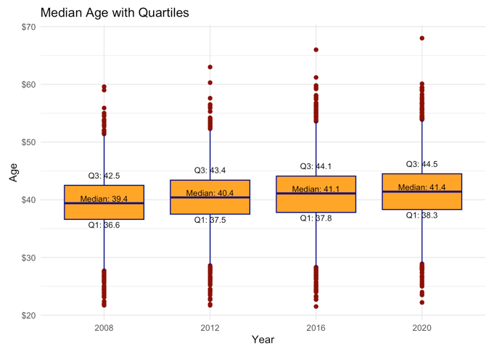
Visualizing Merged Numeric Data
The box plots for continuous variables give us an understanding of the central tendencies and distribution of the data over time. Including this data in our model ensures we reflect changes in financial conditions over the same period as our demographic data.
Increases in Median Household Income, Mortgage Payment, Home Value and Age between 2008 and 2020 election cycles.

Slide 9
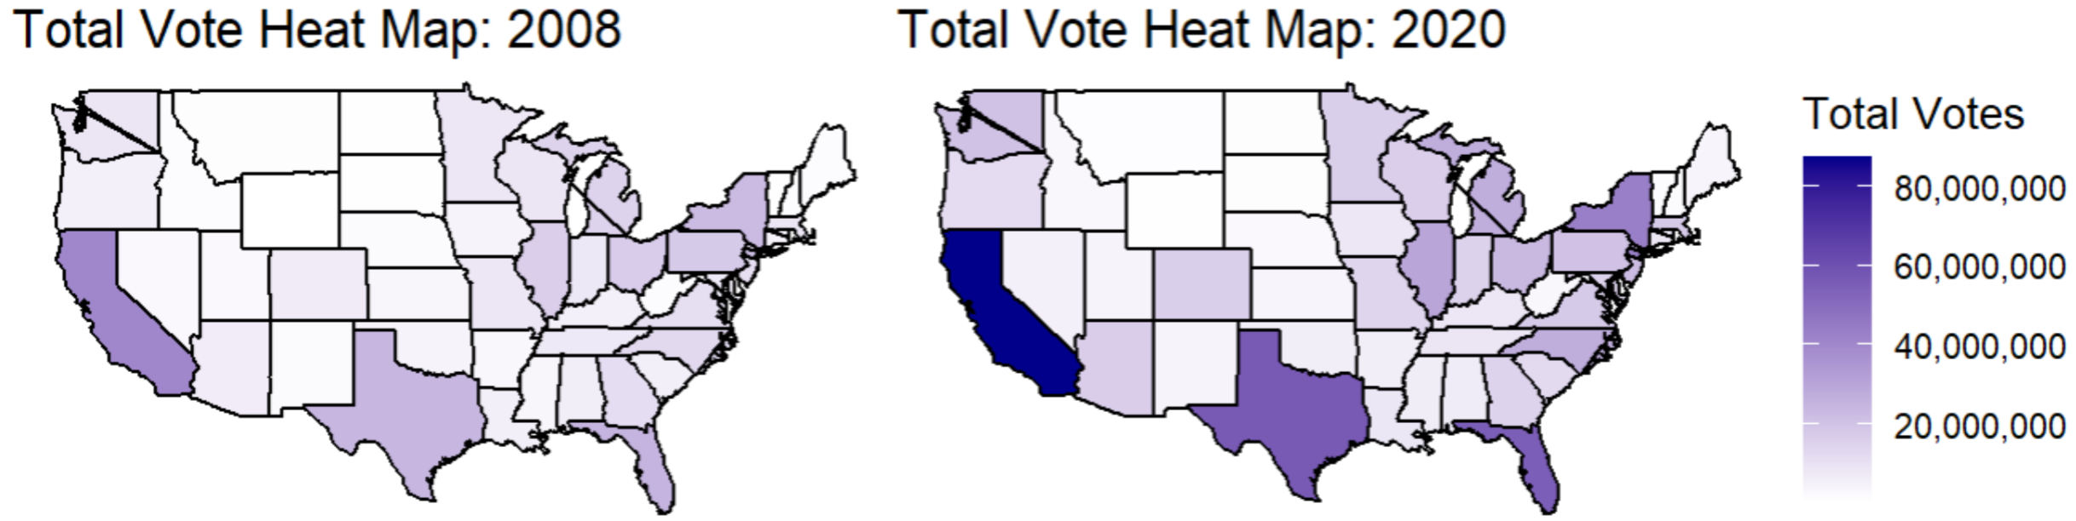
Standardize Demographics
- Insights from Demographic Standardization
Pre/Post-Pandemic Patterns
County Influence Analysis
Electoral Vote Changes
Mail-in ballot usage increased 320% in swing states
Suburban counties show highest volatility
Normalize age categories across census periods
Urban/rural voting divides widened significantly
Demographic shifts correlate with voting changes
Standardize income brackets for temporal comparison
Ensure consistent county identification across datasets
Create consistent education level classifications
https://electionupdates.caltech.edu
https://www.pewresearch.org/politics/2023/07/12/voting-patterns-in-the-2022-elections/

Slide 10
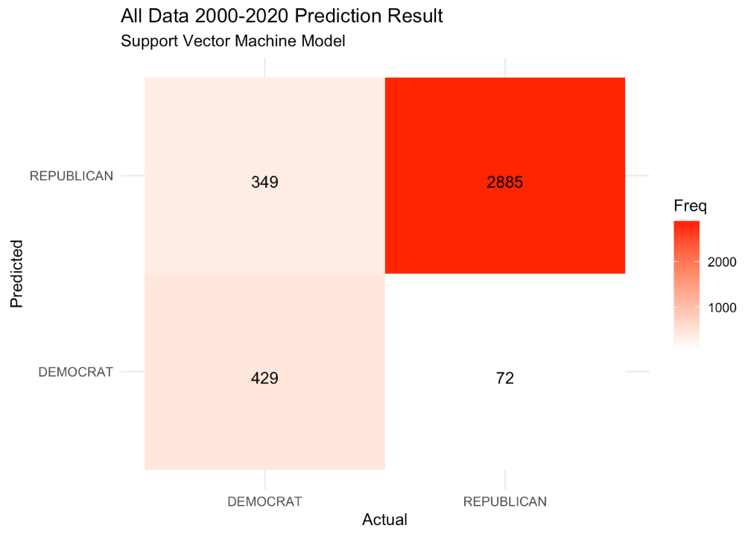
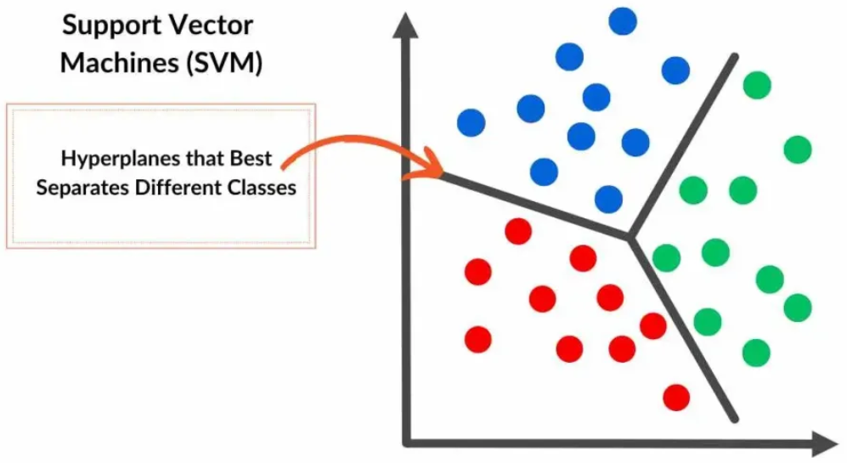
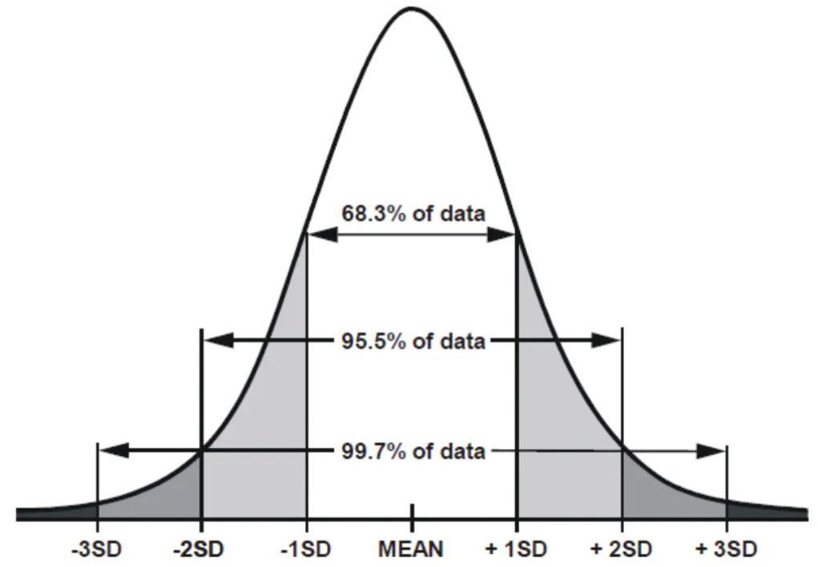
Support Vector Machine: Model Training & Evaluation
Train
70%
TEST
30%
Standard Scaler
Data Preparation & Scaling
Model Setup & Training
Evaluation & Confusion Matrix
Model Parameters:
Kernel: Radial Basis Function (RBF)
Tuned Parameters: C = 3, σ = 0.1
Cross-validation: 3-fold CV
Support Vectors: 2,777
Training Error: 10.6%
Dataset was split into 70% training and 30% test sets
Test Accuracy: 88.7%
The model accuracy appears high however it appears to be memorizing the data
Applied z-score scaling to all numeric features
Metric | Formula | Value
Sensitivity (Recall for DEMOCRAT) | 349 / (349 + 429) | 44.80%
Specificity (Recall for REPUBLICAN) | 72 / (2885 + 72) | 2.40%
Precision (for DEMOCRAT) | 349 / (349 + 2885) | 10.80%

Slide 11
Random Forest Model Evaluation Summary
Performance Comparison Across Candidate Model
Balanced Accuracy / Sensitivity
Model | Accuracy | Kappa | Sensitivity | Specificity | Pos Pred Value | Neg Pred Value | Balanced Accuracy
Random Forest Base | 0.8522 | 0.5381 | 0.5689 | 0.9323 | 0.7034 | 0.8845 | 0.7506
5-Fold CV | 0.8558 | 0.5782 | 0.6661 | 0.9094 | 0.6749 | 0.9061 | 0.7878
RFE + HyperTuned | 0.7998 | 0.4401 | 0.6029 | 0.8554 | 0.5407 | 0.8841 | 0.7291
RFE Base + SMOTE | 0.8522 | 0.5287 | 0.5429 | 0.9396 | 0.7173 | 0.8792 | 0.7413
RFE Base + HyperTuned + SMOTE | 0.8241 | 0.4868 | 0.5981 | 0.8879 | 0.601 | 0.8867 | 0.743
Best Model For: | 5-Fold CV | 5-Fold CV | 5-Fold CV | Base + SMOTE | Base + SMOTE | 5-Fold CV | 5-Fold CV
5-Fold CV outperformed others in balanced accuracy and sensitivity, indicating strong generalizability without resampling.
Among all model configuration 5-Fold Cross-Validation delivered the most consistent and reliable performance across key metrics, including sensitivity and balanced accuracy. It demonstrates strong potential for real-world deployment without overfitting or complex preprocessing.

Slide 12
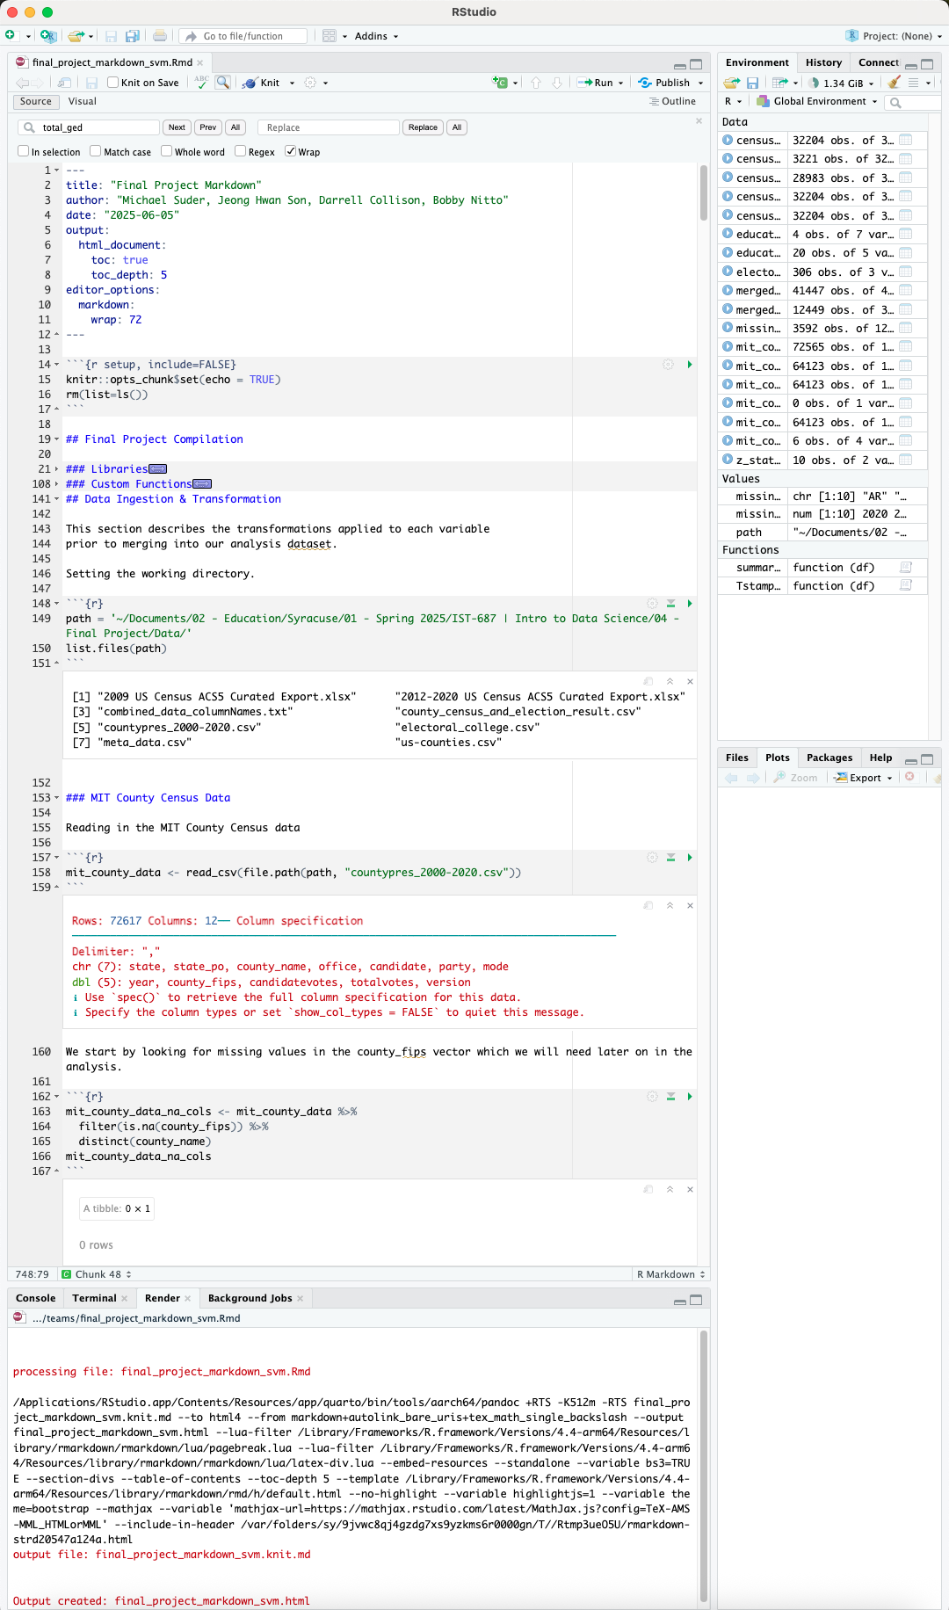
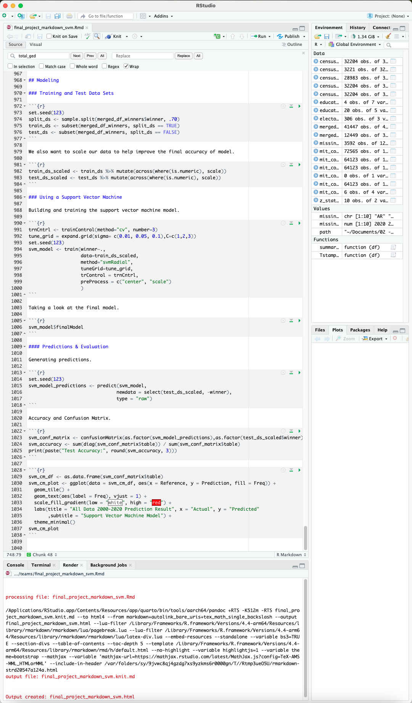
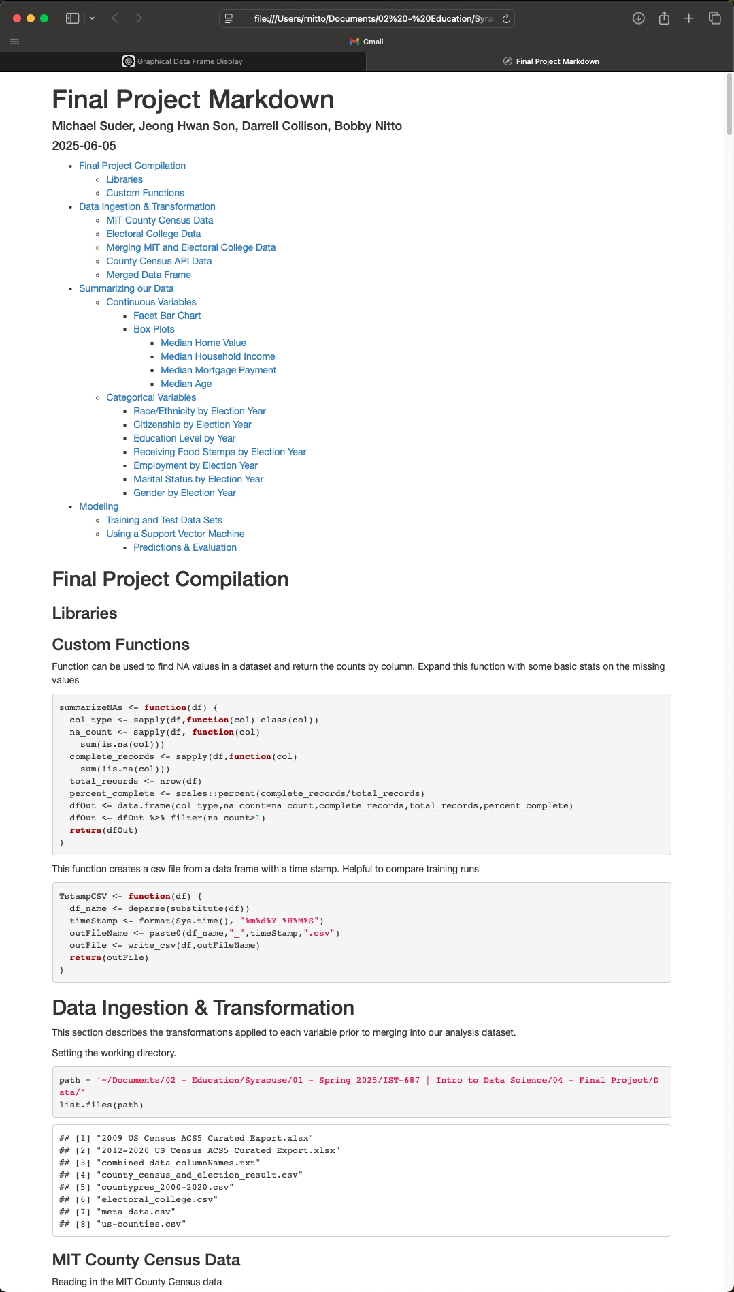
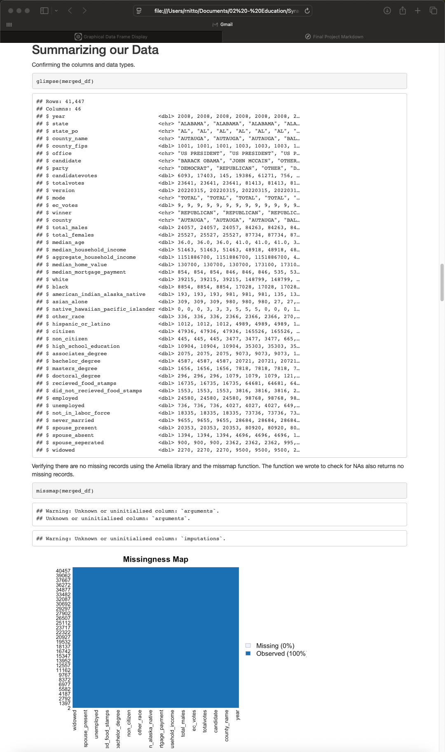
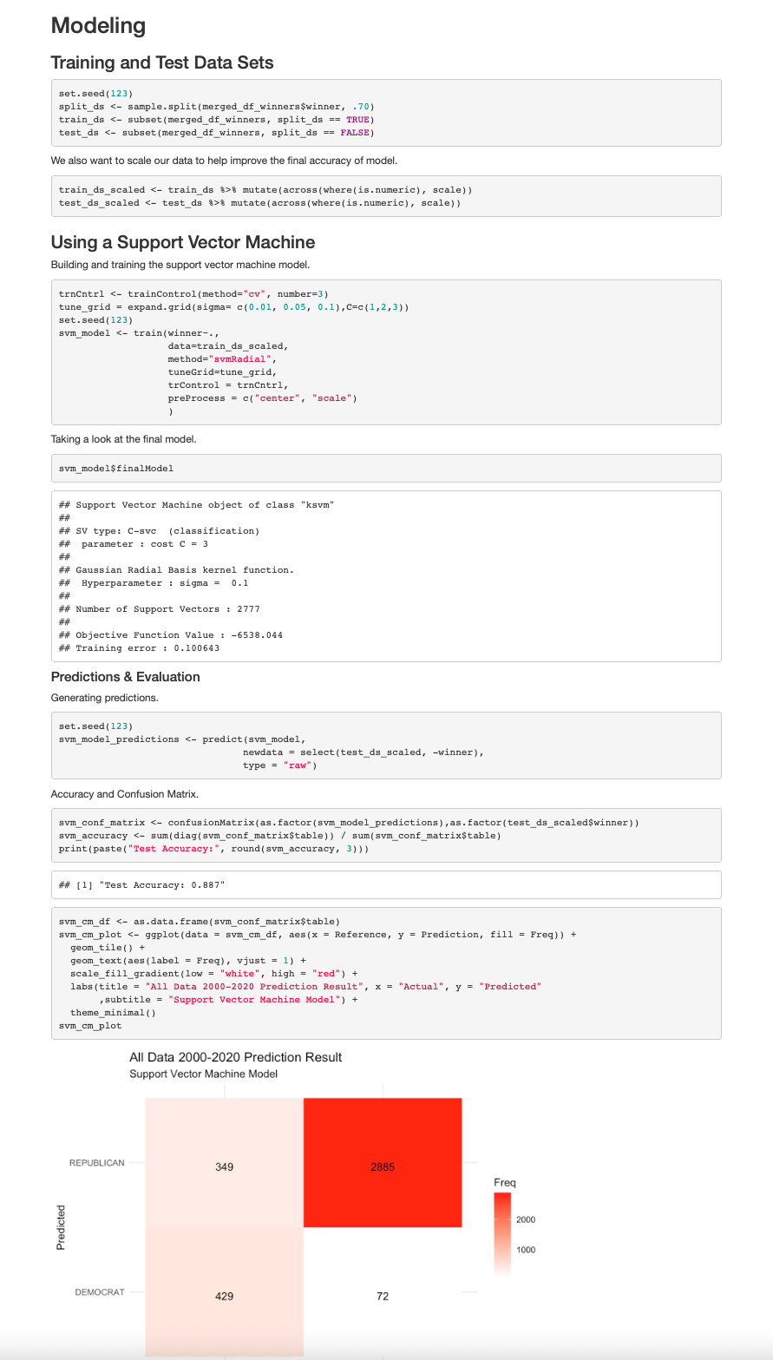
R Markdown and Knit HTML
Our R code is organized in a R markdown file and includes comments about our code, findings and analysis.

